Slide 1
SAFEPORT
security made easy

Slide 2
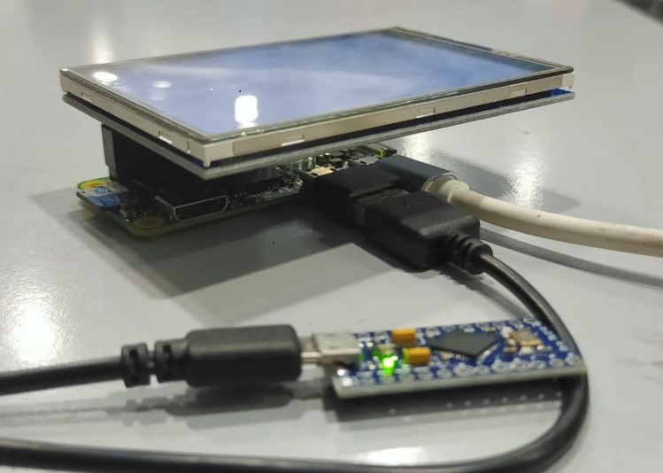
INTRODUCTION
SafePort is an intermediator between USB device and host.
It scan and analyse USB device and gives a simple User Interface to control and
monitor USB device.
Basically it defend against various USB attacks, including HID attack and juice
jacking.

Slide 3


Slide 4
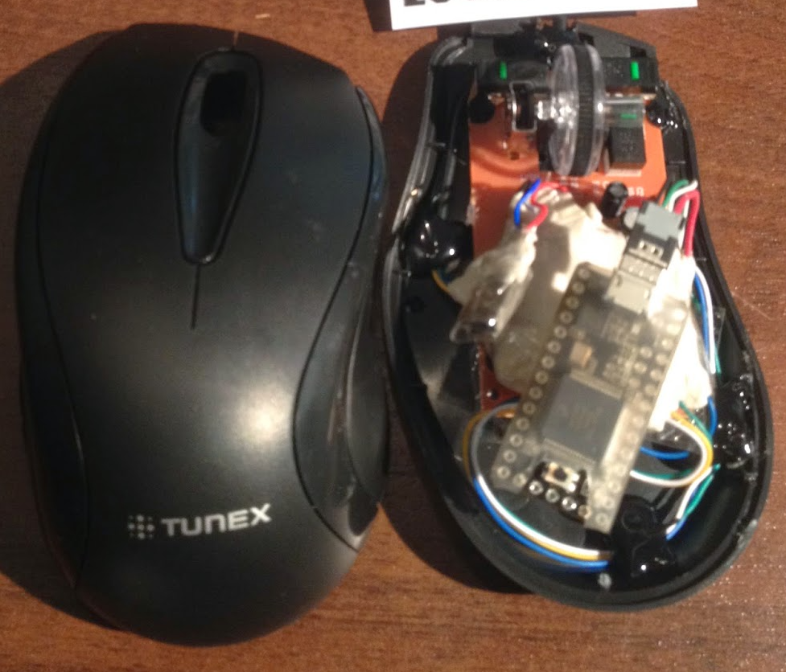

HID AND RUBBER DUCKY ATTACK
In HID attack, an attacker creates a USB device which when plugged into a computer will execute a pre-configured set of keystrokes to drop a malicious payload onto the target computer.
The Rubber Ducky is an attack tool that looks like a USB flash drive but acts like a keyboard when plugged into any unlocked device.

Slide 5
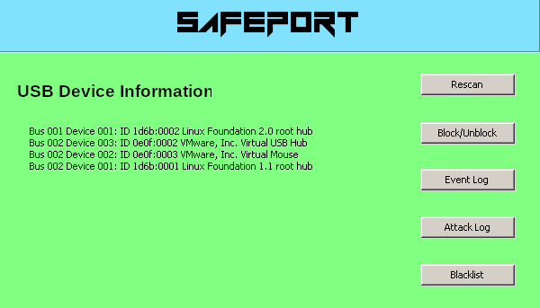
DEFENSIVE MEASURES
USB device blacklist creation
Keyboard dynamics analysis
Enumeration and Monitoring
Logging usb device attach/detach
Safe from network attacks

Slide 6
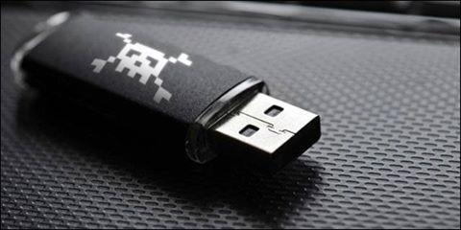
USB DEVICE BLACKLIST CREATION
When a user plugs in a USB Rubber Ducky via SafePort and SafePort shows that an HID device is attached, he/she may raise suspicion because the USB Rubber Ducky device is not an HID device. In this case, the user can blacklist the identified malicious USB device by simply clicking a button on SafePort’s UI.

Slide 7

KEYBOARD DYNAMICS ANALYSIS
Keyboard dynamic analysis detects malicious activity by analysing the typing pattern, the rhythm and the speed of typing on a keyboard, since masqueraded malicious USB device may type inhumanly or with the type speed that is impossible for humans

Slide 8
ENUMERATION AND MONITORING
SafePort monitor logs of USB activities (e.g., time of attachment/ detachment), which could be used as evidence of malicious activity. It provide a user interface such that users can also visualize the USB packets and logs.

Slide 9
SAFE FROM NETWORK ATTACKS
As in raspberry pi zero, there are no ethernet socket, and embedded Wi-Fi antenna, so SafePort works offline. This means there is no internet connection. Therefore SafePort works more securely as there are no chances that SafePort is hacked via the internet.

Slide 10
SAFEPORT IMPLEMENTATION
There are three major sections of implementation of SafePort:
SafePort Hardware Implementation using Raspberry pi zero with a 3.5” LCD touchscreen
SafePort Software Implementation using python

Slide 11
SAFEPORT HARDWARE
IMPLEMENTATION
SafePort is mainly built on a Raspberry Pi zero , an affordable IoT development board with a Debian-based Linux system.

Slide 12
SAFEPORT SOFTWARE
IMPLEMENTATION
The main programming language we use is Python. The graphical User Interface is built using the Tkinter library. Tkinter provides a fast and easy way to create GUI applications. SafePort uses the Python wxpython and pywinusb library for USB device management to track USB attachment/detachment time.
Safeport also uses pywin32 and pyhook library for keyboard dynamics analysis.

Slide 13
FUTURE WORK
We will use a relay module that consists of 2 TRX-3V Relay ICs that are responsible for relaying USB signals after the SafePort’s scanning and analysis procedure. This module ensures that the connected USB peripherals are not malicious.
After the relay module redirects the USB signal to the host computer, SafePort needs to passively listen to continue protecting the host computer. We implement passive listening by using BeagleBone Black (BBB) Beaglelogic, a logic analyzer that is capable of capturing USB traffic at speed up to 100MHz.

Slide 14
CONCLUSION
Our aim is to provide an effective defensive framework for protecting USB peripherals against various attacks, in addition to HID and juice jacking attacks.
And also provide a secure USB hub which automatically scan, analyse, redirect, or block a USB device that is connected through the secure USB hub.

Slide 15
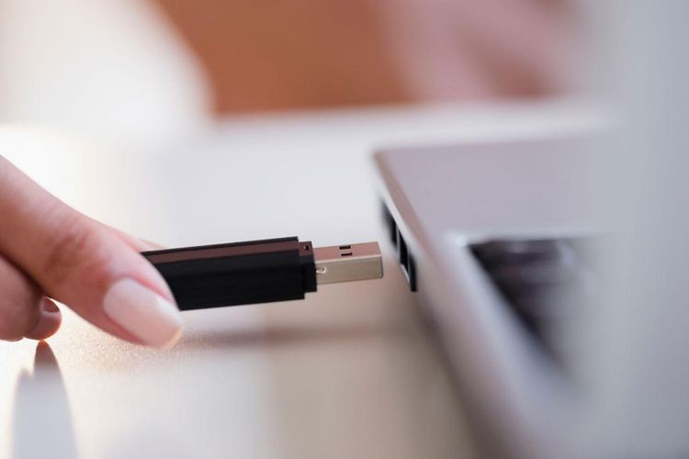


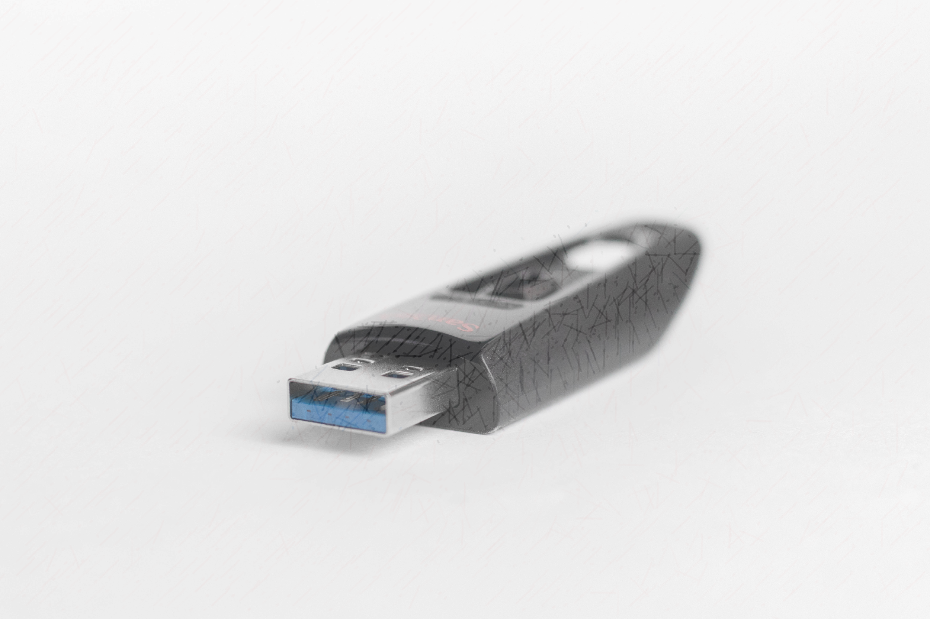







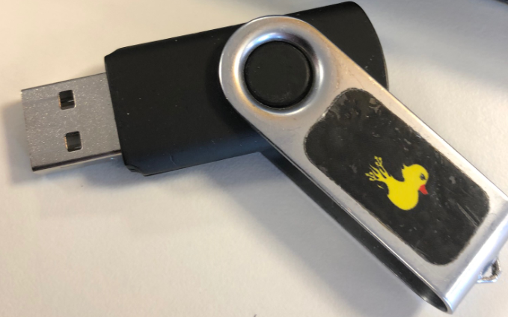
THANKYOU

